Slide 1
UNCLASSIFIED
SPECIAL OPERATIONS FORCES INDUSTRY CONFERENCE
Win Transform People
Lisa Sanders Director, Science and Technology

Slide 2
UNCLASSIFIED
SPECIAL OPERATIONS FORCES INDUSTRY CONFERENCE
Win Transform People
COL Michael McGuire Director, Combat Developments
FUTURE OPERATING ENVIRONMENT

Slide 3
Future Operating Environment
The Future Operating Environment is a world of “Convergence”: the point where the gap between non-state and state actor capabilities diminishes and the threat to force and mission success increases significantly.
SOF’s “Bold Ambitions” are to be more:
1) AVAILABLE: Agile and mobile enough to be decisive
2) INVISIBLE: Deny the ability to obtain decisive information
3) OMNISCIENT: Maintain information overmatch
4) INVULNERABLE: Defeat lethal and targeting capabilities
Special Operations Forces missions will not significantly change, but the environment in which they are conducted is, and will continue, to change significantly.

Slide 4
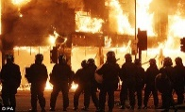
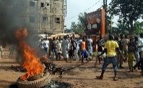
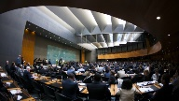
Future Operating Environment
Themes
Trends
Notional Missions
Chaos
Unrelenting, far-reaching transformation that disorders beliefs and weakens traditions
Constraint
Institutional inadequacies, weakening global institutions, increased competition
Convergence
DISTRIBUTION A: APPROVED FOR PUBLIC RELEASE
4

Slide 5
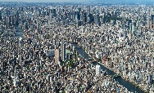
Future Operating Environment
Themes
Trends
Notional Missions
Technology Proliferation
Equal access across markets
Individual Empowerment
Individuals enjoy state-like power
State Competition
Nations compete short of war globally
Urbanization
Cities become dominant terrain feature
Resource Realities
Defense budgets and capacity declines
Institutional Limitations
Legacy systems constrain Special Forces

Slide 6
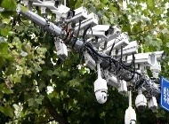
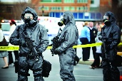
Future Operating Environment
Themes
Trends
Notional Missions
Mega City Raid
Precision raid under persistent threat and scrutiny in both “denied” and “permissive” areas.
Proxy War
Using proxies, surrogates, and special activities to counter near-peers while subject to state level scrutiny and threat.
Global Man Hunting
Counterterrorism in non-permissive areas and against a dispersed enemy
Weapons of Mass Destruction Disruption
Disrupt state and non-state actor WMD in permissive or non-permissive environments

Slide 7
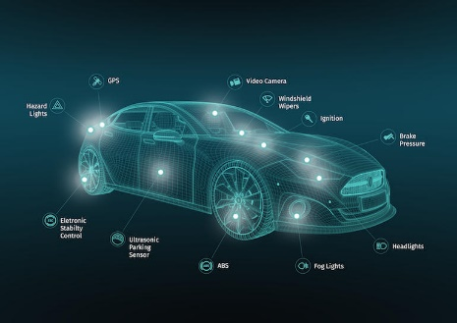
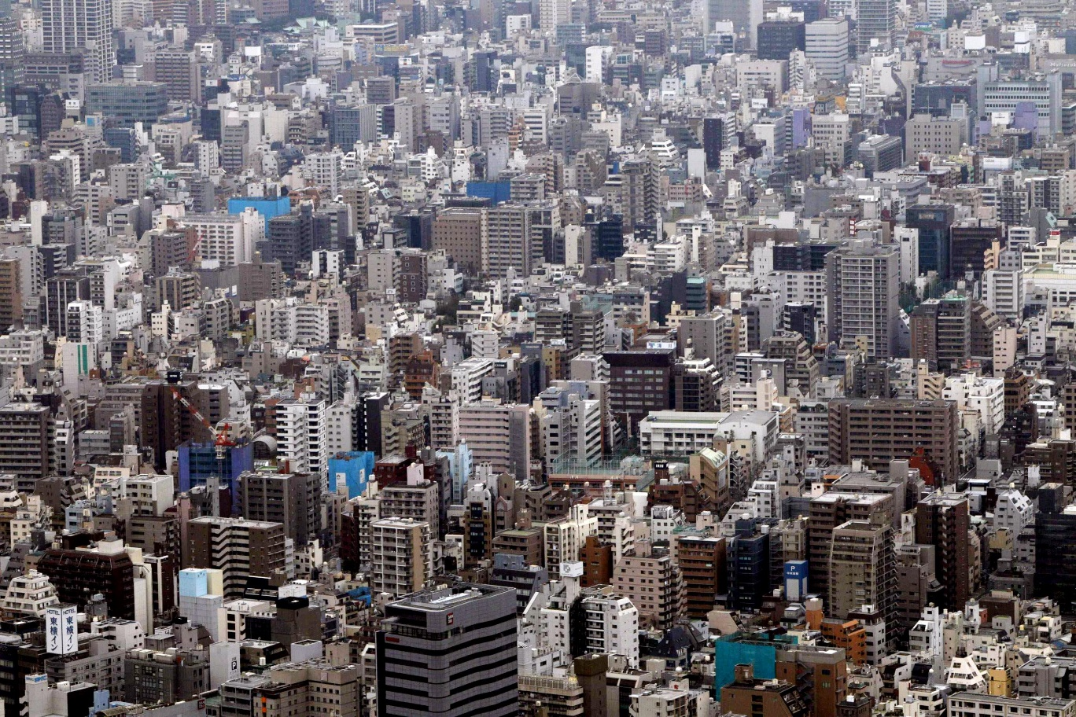
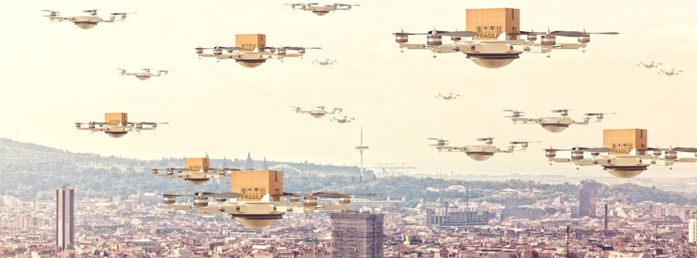
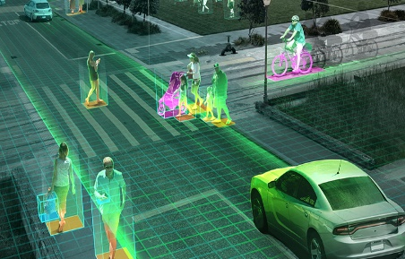
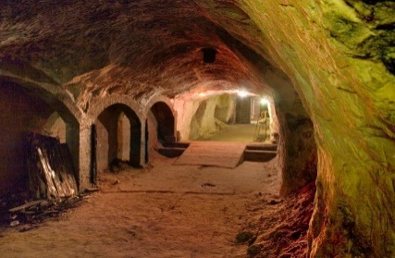
Notional Mission: Mega City Raid Challenges
Cars
By the thousands, both self-driving and with drivers
Clog roads, limiting rapid movement
Potential sensor data requiring Artificial Intelligence and Big Data Analytics to exploit
Drones
By the thousands, some with facial recognition artificial intelligence
Clog sky, blocking communications networks
Relays real-time ground force location
Armed drones concealed in delivery and other use drones
Global Coverage
Mobile cameras capture and upload everything via commercial encryption for live-viewing across the globe
Social media and crowdsourcing generate potential tactics
Special Forces Operators were collected on and tracked from point of origin to point of operation
Cyber
Hired hackers, and volunteers hack the city Closed Circuit Cameras and TV
Navigation systems are spoofed to misdirect forces
Subterranean
Cities moving underground
Maze of tunnels and sewers
Traditional communications denied
Denied Access Zone
Extremely hostile
Heavily surveilled
No government influence

Slide 8
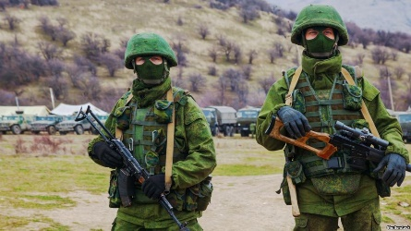
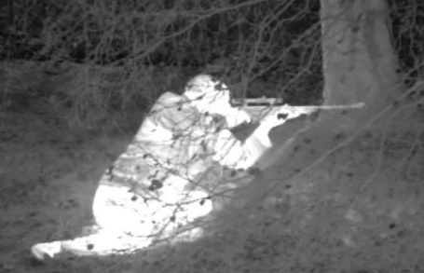
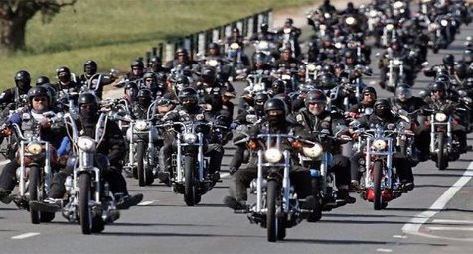
Notional Mission: Proxy War Challenges
Anonymous actors
No state ownership of personnel conducting military-like actions, challenging legal and policy responses
Military-grade equipment
Insurgents or other adversaries have access to technologies that reduce SOF physical invisibility
State Collection
State Signals Intelligence assets are used in combination with human networks and open source information focused on SOF units and their families
Internet of Things and Artificial Intelligence
Allows access to information that can be used to identify plans, movement, personnel and aid intelligence collection efforts
Encryption
Communication occurs easily across the globe via commercially encrypted apps
Non-attributable Cyber
Collect on SOF personnel and movements
Conduct information operations to provide false information
Prevent the use of key SOF Command and Control assets
Non-conventional actors
Paramilitaries
Motorcycle gangs to cause disruption
Mass refugee movements to complicate responses
DISTRIBUTION A: APPROVED FOR PUBLIC RELEASE
8

Slide 9
Future Operating Environment
Technology Focus Areas: Within the next 5-7 years, Special Operations Forces need to be able to address critical needs in the following areas:
Contested Environment Situational Awareness
Counter-Autonomous Systems
Next Generation Characterization and Identification
Strategic and Tactical Signature Management
Tactical Communications/Navigation
Tactical Remote Autonomous Systems and Human/Machine Interface
Data Analytics/Visualization (as an enabler across all Technology Focus Areas)

Slide 10
UNCLASSIFIED
SPECIAL OPERATIONS FORCES INDUSTRY CONFERENCE
Win Transform People
Lisa Sanders Director, Science and Technology
FUTURES PROCESS/FUTURES FOUNDRY

Slide 11
S&T Futures Process
A Foundational Process that is Flexible/Adaptable and Provides a Framework
Iterations Are Mission/Objective Focused and
Enable Brainstorming/Ideation
11

Slide 12
UNCLASSIFIED
UNCLASSIFIED
S&T Futures Process
1

Results
2
MATERIEL
APPROACHES
Leap Ahead
Asymmetric
Divergent
NON-MATERIEL
Policy, Authority
& Doctrine
Assess & Describe
Impact/Opportunity
NEW PROBLEM
IDENTIFICATION
Opportunity
Threat
Follow-on
Analysis
Results
3

Rapidly Changing Technology
CONSIDERATION
4

Changing Environments
CONSIDERATION
3

Varying Mission Objective
(Measures of Success)
CONSIDERATION
2
CONSIDERATION
1

Changing Strategic Conditions
Designed by PresentationGo.com
UNCLASSIFIED
12

Slide 13
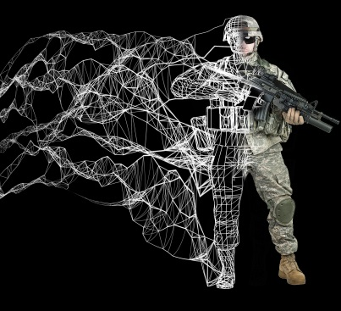
SOF Futures Foundry Events
SOF Futures Foundry Events use a Design Thinking Approach to Explore Concepts from Future Technology Areas and how they Impact Potential Missions for Future SOF Operators Inaugural SOF Futures Foundry Event Took Place In October 2017
Incorporated Design Thinking
Leveraged Diverse Participants
Using 2 SOF Mission Scenarios, Identified 24 Futures Concepts and Associated Sub-concepts/key Technologies with the Potential to Revolutionize SOF Missions 10-15 Years in the Future
13

Slide 14
SOF “Futures Foundry” Event
Next Futures Foundry Event is Scheduled to take Place in June 2018
Will Incorporate Design Thinking and Leverage Diverse, Non-traditional Participants
Hyper Enabled Operator is Embedded Within this Construct
New Set Of SOF Mission Scenarios, that are Based on the Future Operating Environment, will be used to Identify Key Technologies with the Potential to Revolutionize SOF Missions 5-10 Years in the Future
14

Slide 15
QUESTIONS?

